Slide 1
Job Application Package Assignment
Where to find the assignment rubric and your individual feedback

Slide 2
Job Application Package Assignment – Evaluation and Feedback
Job Application Package Assignment is one of the essential co-op and job readiness activities and is evaluated in Brightspace
Job Application Package requires a submission of a resume and a cover letter customized to a sample job posting
These documents must be submitted as one PDF or Word document; .ZIP or .RAR file formats cannot be evaluated in Brightspace
Assignment Rubric
  Outlines the evaluation criteria for the assignment and provides the first level of feedback
Individual Feedback and Suggestions
  Individual feedback for this assignment is provided using a program called Turnitin
  Students can access their individual feedback by following the View Turnitin Online Grading link

Slide 3
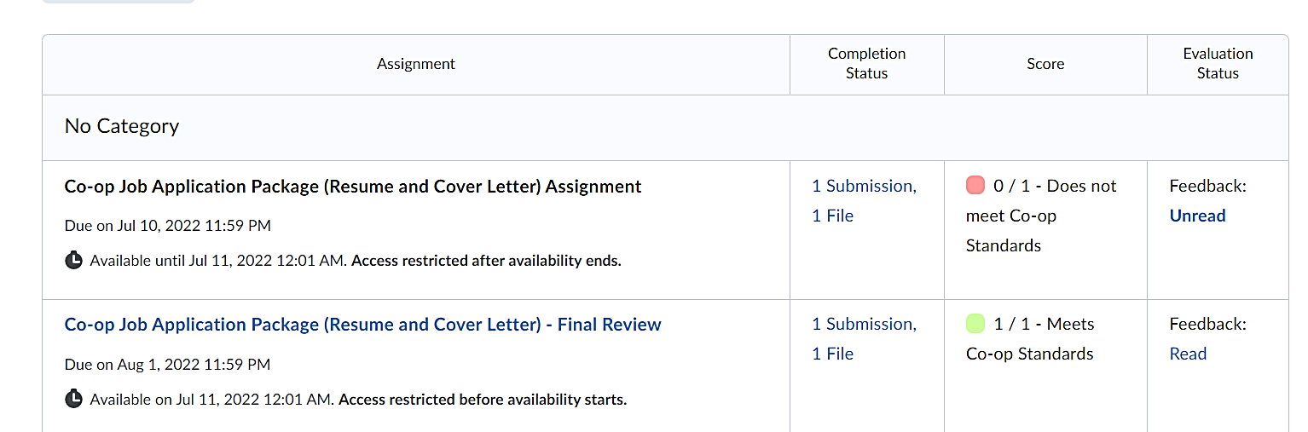
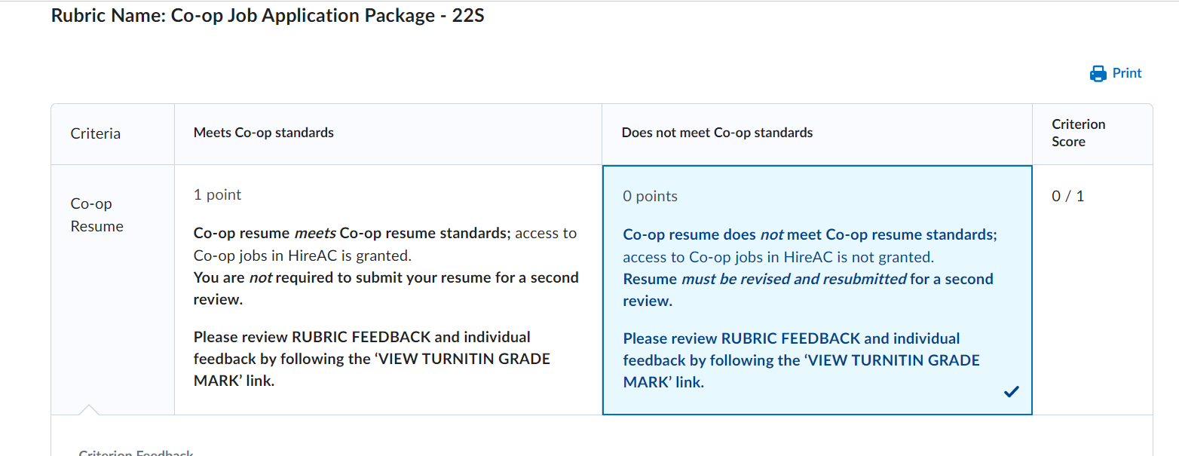
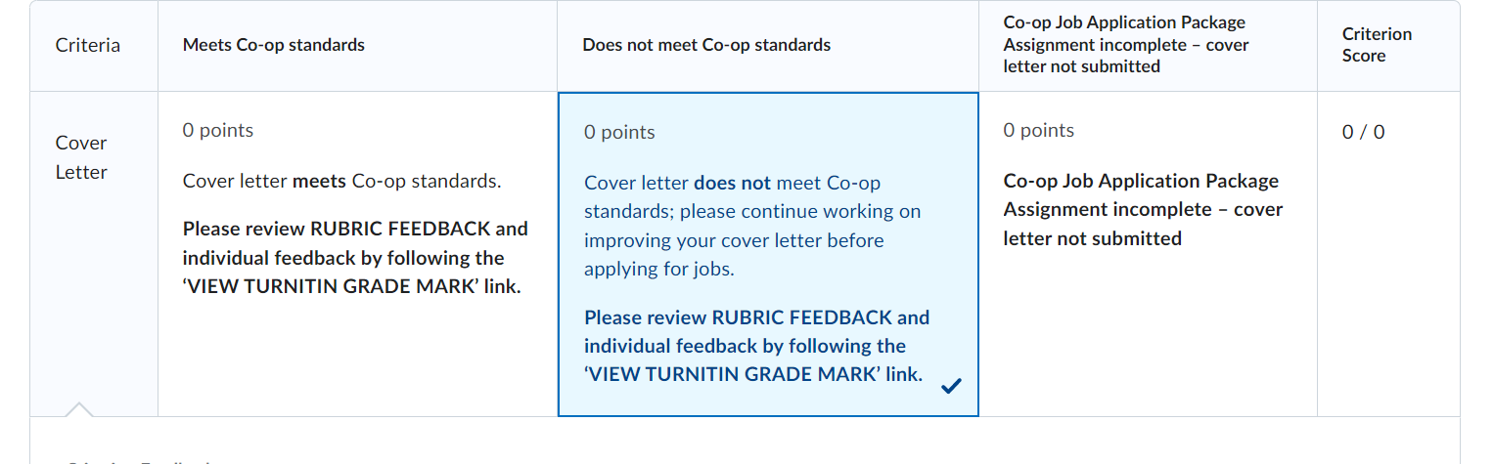
Co-op Job Application Package Assignment – Rubric
Log into Brightspace, GEP1001
Go to Activities > Assignments
Follow the links from either the Completion Status or the Evaluation Status columns to navigate to the assignment rubric and to the View Turnitin Online Grading link, where you will find your individual feedback
Review the feedback from the Assignment Rubric for both your resume and cover letter
Scroll down the page to get to the View Turnitin Online Grading link and review your individual feedback

Slide 4
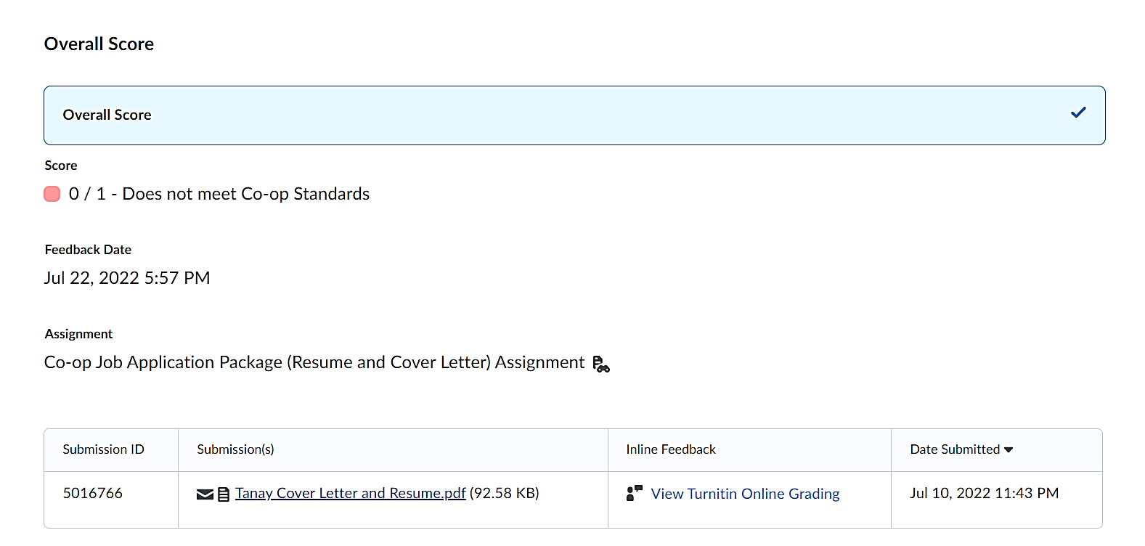
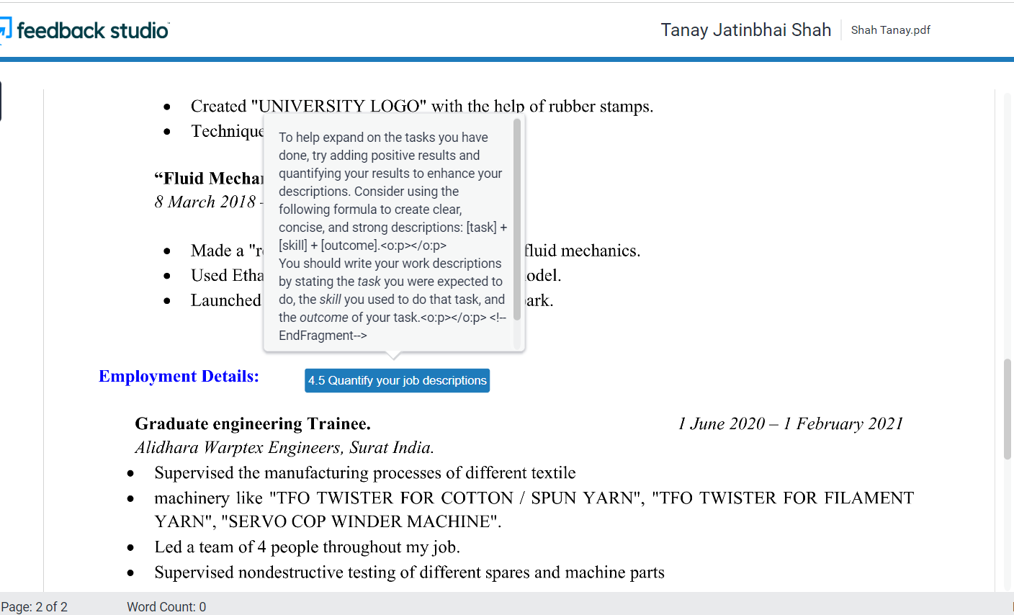
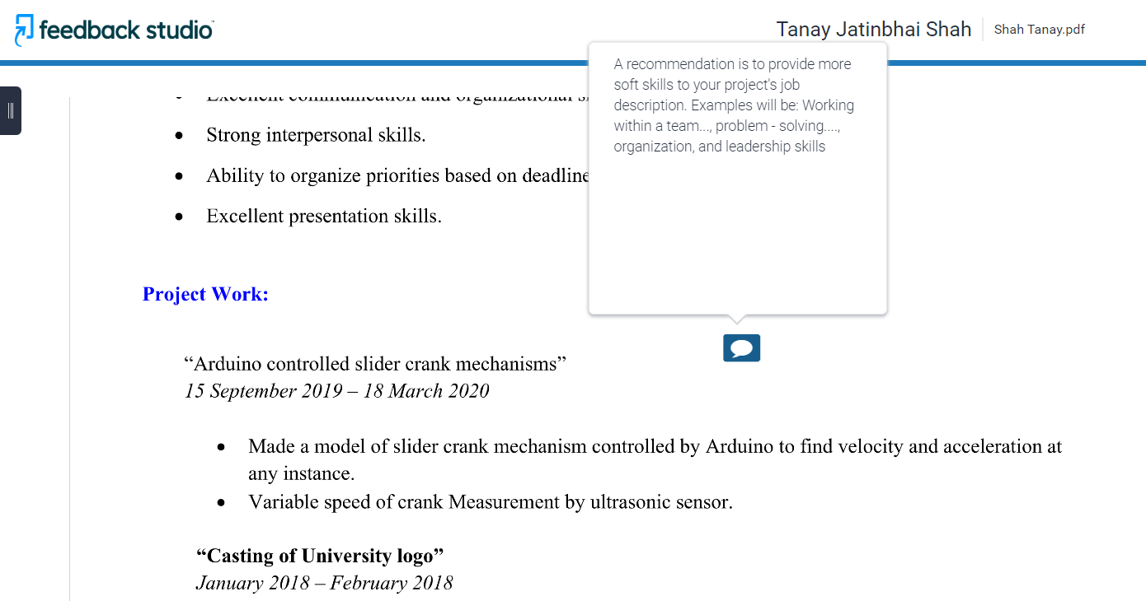
Individual Feedback - Turnitin Online Grading link
Follow the View Turnitin Online Grading link to review your individual resume and cover letter feedback
Open Turnitin and click on each of the feedback points to review your detailed feedback and suggestions

